Slide 1
Digital Image Processing in Python
Alon Oyler-Yaniv – alonyan1@gmail.com
https://github.com/alonyan/DIP

Slide 2
Workshop goals
The workshop is an introduction to digital image processing, designed to give you a taste of what's possible with a specific emphasis on microscopy data.
By the end of the workshop, you should:
Acquire basic understanding and familiarity with computer vision.
Appreciate the importance of rigorous and systematic image analysis for reproducible and quantitative science.

Slide 3
Computational Image processing
Image processing is about extracting the relevant data from your measurements, but not about analyzing them.
Monkey ID | M/F | size | Coat Color | Attr 1 | Attr 2 | Attr 3 | …
1 | F | 24 | …
2 | F | 40
3 | M | 87
4 | M | 21
5 | F | 31
6 | F | 24
7 | F | 54
Something something computers…

Slide 4
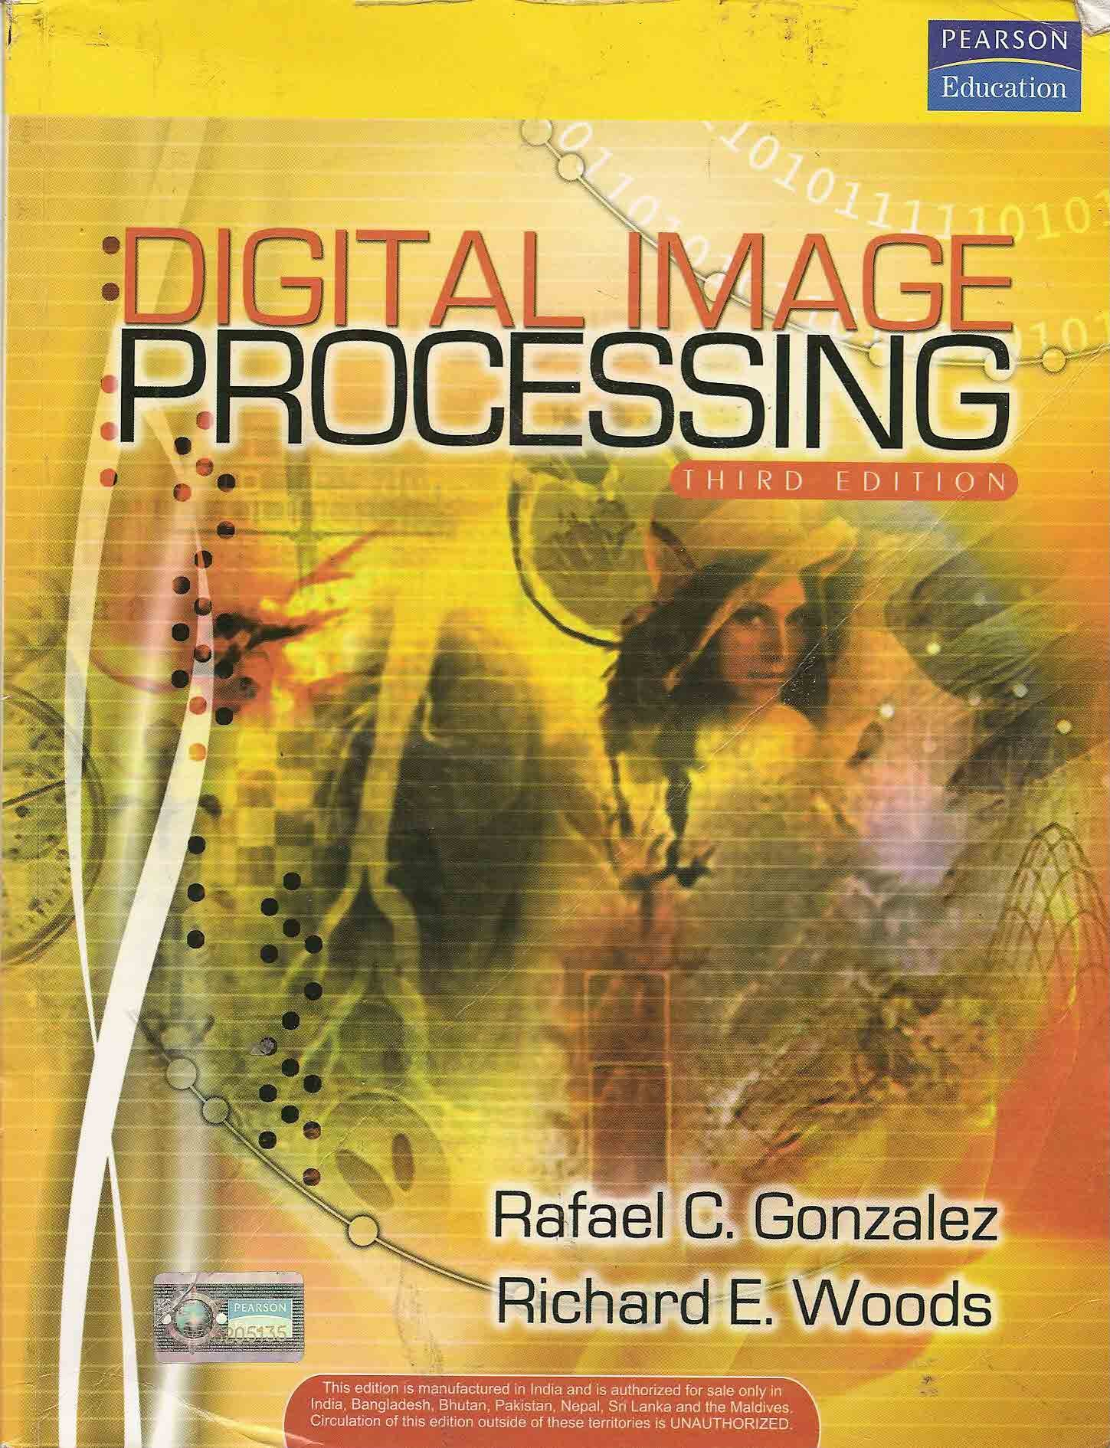
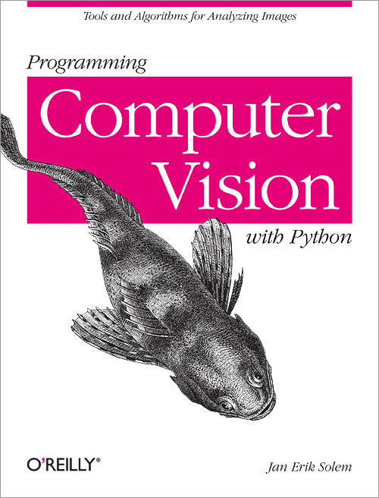
Other resources
MOOC: https://www.mooc-list.com/course/image-analysis-methods-biologists-futurelearn
http://web.ipac.caltech.edu/staff/fmasci/home/astro_refs/Digital_Image_Processing_2ndEd.pdf
http://programmingcomputervision.com/

Slide 5
Overview of approach
Image Signal
Conditioned Image Signal
Image Derived Parameters
Understanding Image Content
Denoising, thresholding
Low-level vision
Masking, filtering
All parameters and features are user defined, many heuristic (Wheelness of an object…)
Intermediate-level vision
Feature extraction, feature engineering
High-level vision

Slide 6
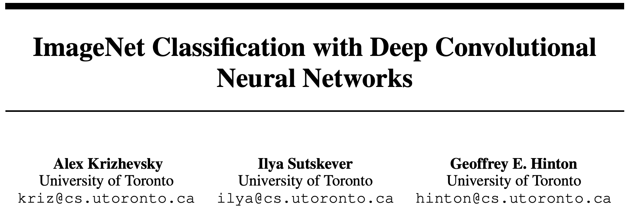
2012 – AlexNet : Breakthrough in computer vision
Won ImageNet – a image recognition competition by a wide margin
Onset of Deep learning

Slide 7
Artificial Neural Networks (ANNs)
Inspired by biology, ANNs are computational systems that can learn a set of parameters that translate a given input to a desired output.
ANNs are trained by providing large sets of annotated data (training set).
Ideally, after training, ANNs are capable of using the learned information to interpret new data.
The theory of these has been developed since the 40s
Was always considered cute but computationally unfeasible

Slide 8
Convolutional Neural Networks (CNNs)
CNNs are ANNs that use convolution (e.g. filtering) as part of the network architecture.
They are particularly useful for computer vision as they are able to learn features over a wide range of scales

Slide 9
Conceptual differences
Traditional programming:
Input
Program
Output
Logic is predefined by the programmer
Machine learning:
Input
Output
Program
Logic is learned from examples

Slide 10
2012 – AlexNet : Breakthrough in computer vision
The big breakthrough was computing everything on GPUs, which are way more efficient for these tasks.
>47000 citations as of Oct. 2019
*not technically first, but most influential

Slide 11
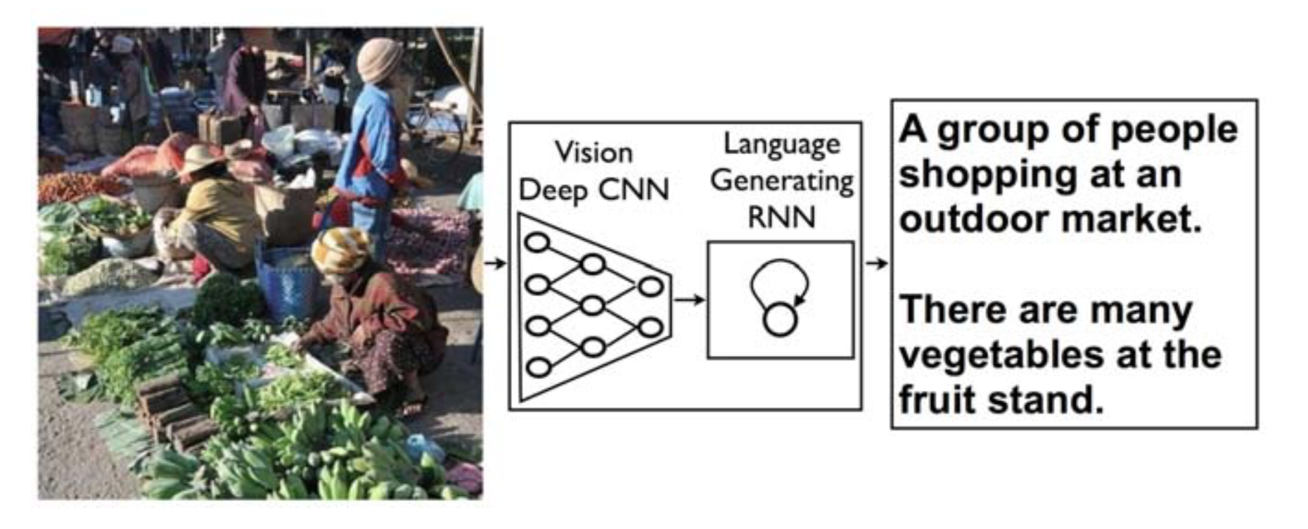
2014 – From image classification to image description
Image classification was then extended to the more challenging task of generating descriptions (captions) for images.
Google, Stanford University

Slide 12
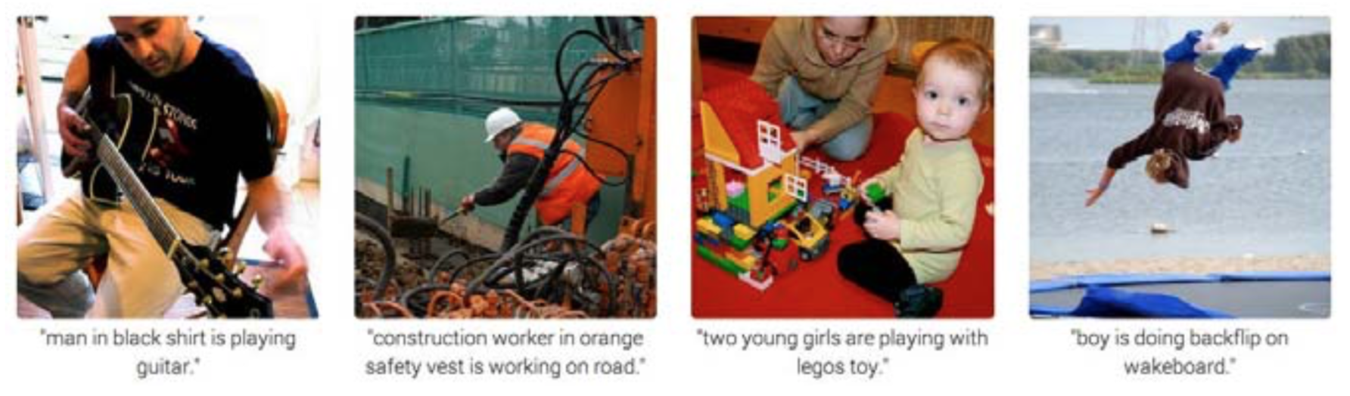
2014 – From image classification to image description
Image classification was then extended to the more challenging task of generating descriptions (captions) for images.
Google, Stanford University

Slide 13
2014 – From image classification to image description
Image classification was then extended to the more challenging task of generating descriptions (captions) for images.
All of these parameters are learned by the computer during training
Google, Stanford University

Slide 14
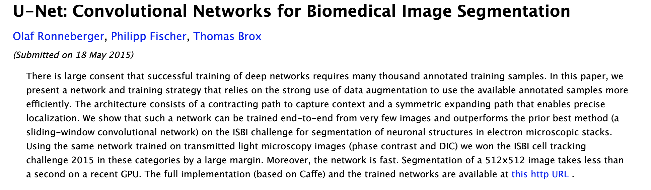
2015 – U-Net, First biological application of CNNs

Slide 15
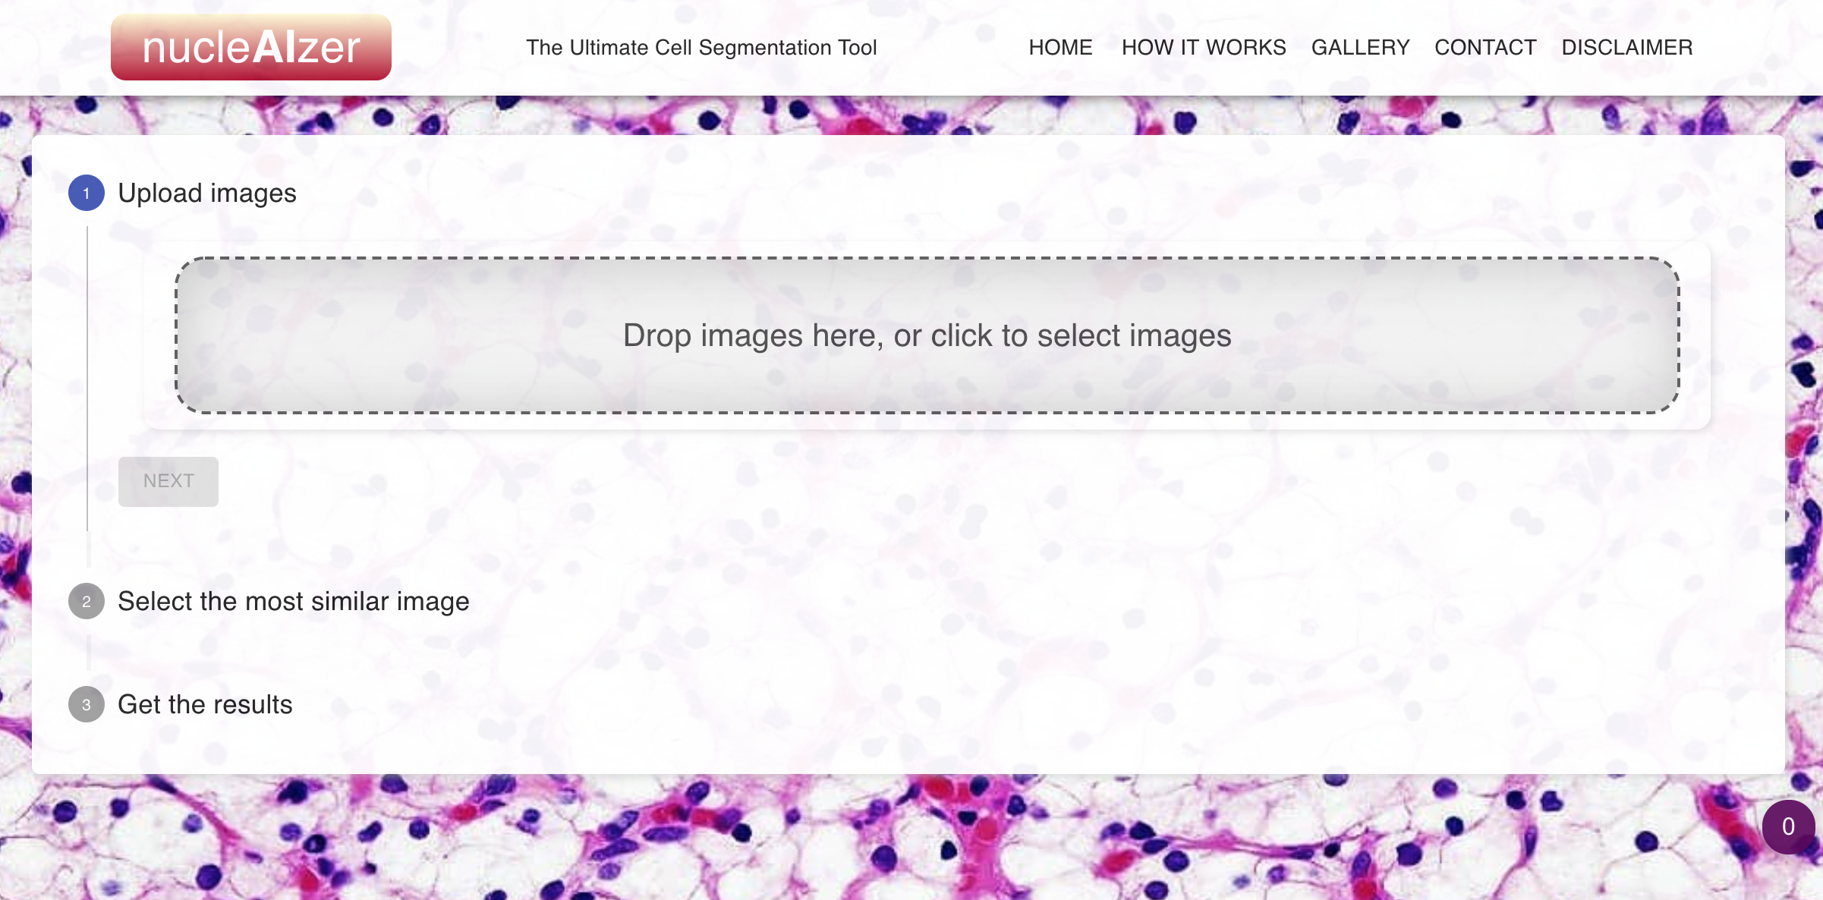
2018 – Deep learning based web tools
http://deepcell.org/
http://nucleaizer.org/
Future is bright!

Slide 16
Open questions
Interpretability of hidden layers
Learning from few examples: On a large no. of problems, humans learn from very few examples, like hand-writing recognition. Machines require many more examples.

Slide 17
For more on this
https://qcb.ucla.edu/collaboratory-2/workshops/w17-machine-learning-with-python/
https://www.coursera.org/learn/machine-learning
https://www.fast.ai/
https://www.udemy.com/course/advanced-computer-vision/
https://www.udemy.com/course/python-for-computer-vision-with-opencv-and-deep-learning/
https://www.udacity.com/course/deep-learning-nanodegree--nd101

Slide 18
Please help us get better! (by filling a short survey)

